Slide 1
Can Stock Market Forecasters Forecast?
Author: Alfred Cowles 3rd
Presented by Xueyi (Lucy) Chen
Notes:
Good afternoon everyone. The paper that I will share with you today is called can stock market forecasters forecast.

Slide 2
Alfred C. Cowles, 3rd (1891-1984)
Graduated from Yale in 1913
Founder and president of the Cowles Commission
Primary concern in 1932 was to elevate economics into a more precise science using mathematical and statistical techniques
Notes:
The paper is written by alfred cowles in 1932. He graduated from yale in 1913 and was the Founder and President of the Cowles Commission.
Mr. Cowles’s primary concern in 1932 was to elevate economics into a more precise science using mathematical and statistical techniques.
Although it’s long time ago, the empirical research and those results presented in this study is still meaningful in today’s financial world.

Slide 3
Introduction
Analyze the forecasting effort of 45 professional agencies
First part: foretell which specific securities would be most profitable
16 financial services
20 fire insurance companies
Second part: estimate the future course of the stock market
William Peter Hamilton (WSJ)
24 financial publications
Notes:
This paper presents results of analyses of the forecasting efforts of 45 professional agencies. All forecasters are well-known organizations in the different fields represented.
Basically, this paper can be divided into two parts. First, it formed two groups 20 fire insurance companies and 16 financial services. Both groups try to predict which specific securities would prove most profitable. Second, it deal with the efforts of 25 financial publications to foretell the future course of the stock market.

Slide 4
Forecasting the Course of Individual Stock Price - 16 financial services
Timeframe: 4¹/₂ years ending July,1932
Data: about 7,500 separate recommendations
Method:
Record each week the name and price of each stock recommended for purchase or sale by each service
Record advice to sell or cover the commitment previously advised
Calculate percentage gain or loss on each such transaction and record the stock market performance for the identical period
Assumptions:
Survivor bias → strike balance every six weeks
Redistribution of funds in equal amounts among all stocks recommended at the beginning of every six month’s period analyzed
Notes:
First, let’s take a look at performance of 16 financial services in forecasting individual stock price.
The time frame in this case is 4 and half year and they recorded 7,500 recommendations in total made by all these firms.
The method they used is first … then …
There are two assumptions made in this research. First, since there is tendency of survivor bias, which means if … but … they won’t make a follow up recommendation to sell the stock. So to deal with this problem, they will drop a stock from the list six months after it had been last recommended when specific advice to sell was not given.
Second, …

Slide 5
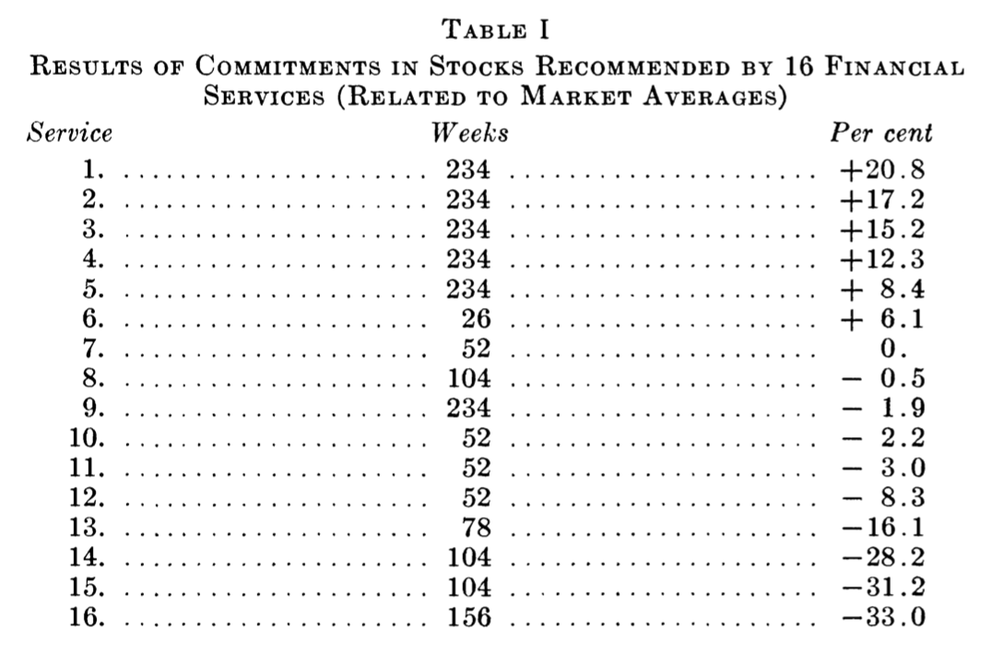
Results -- Only six of the 16 services achieved any success
Average annual effective rate: -1.43%

Slide 6
Forecasting the Course of Individual Stock Price – 20 fire insurance companies
Timeframe: 1928 – 1931
Differences as compared to financial services
Longer history
20-30% stock investment (5% annual average turnover)
Implementation: Same as before
Assumptions:
Consider actual purchases and sales rather than the entire portfolio
All stock purchase are weighted equally
Any item has no purchase record for 12 months was automatically considered sold
A second purchase of an item was omitted unless a sale of this item intervened
Notes:
Now, let’s look the performance of 20 fire insurance companies. Will they perform better compared to financial service?
The time frame in this case is 4 years from 1928 to 1931.

Slide 7
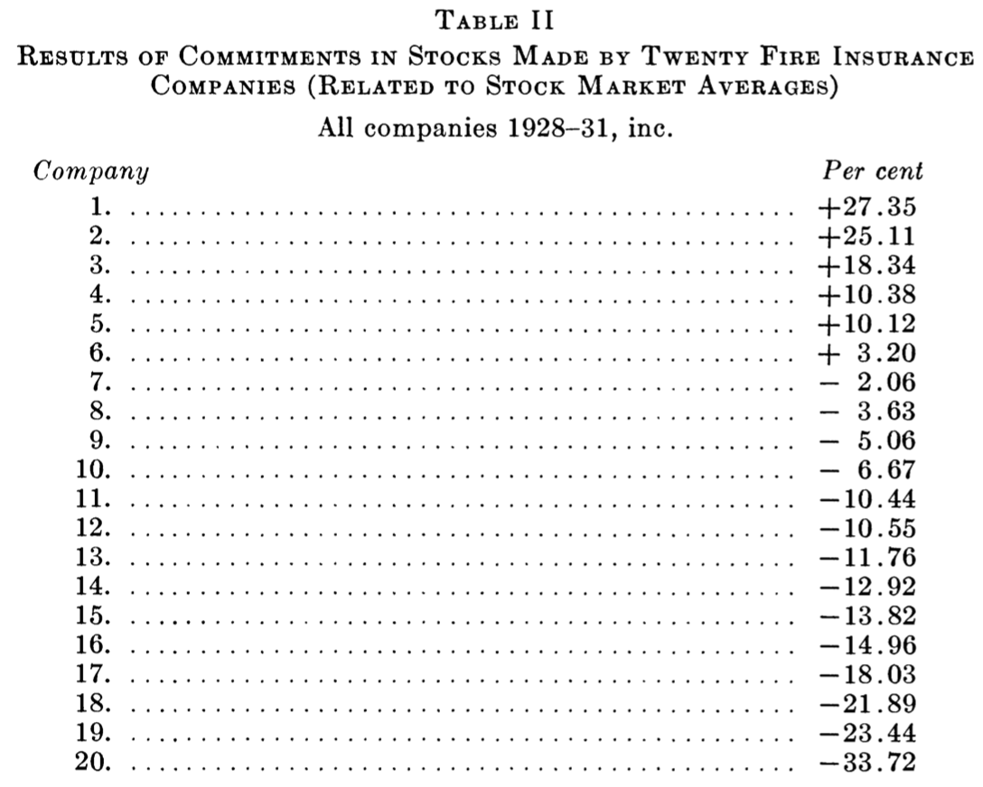
Results -- Only six companies achieved any success
Average annual effective rate: -1.2%
Notes:
So we can tell that both financial services and insurance companies performed below market average and their forecasting ability may not be as well as we imagined.

Slide 8
Forecasting the Course of Stock Market -- William Peter Hamilton
Fourth editor of the Wall Street Journal and a proponent of Dow Theory
26-year (1903-1929) forecasting record (255 editorials)
Method:
Market scoring as bullish, bearish, or doubtful
When bullish is assumed, buy equal dollar amounts of the stocks included in DJIA and sell only when he become bearish or doubtful
When bearish is assumed, short equal dollar amounts of stocks stocks included in DJIA and cover only when he become bullish or doubtful
When doubtful is assumed, abstain from trading
Notes:
Now, let’s turn to a consideration of skill in predicting the course of the stock market as a whole.

Slide 9
Results
William Hamilton’s forecast | Dow Jones Industrial Average
12% | 15.5%
William Hamilton’s forecast | Dow Jones RailRoad Average
5.7% | 7.7%
Change of Position Recommendations | Total | Profitable | Unprofitable
Bullish | 29 | 16 | 13
Bearish | 23 | 10 | 13
Withdrawal | 38 | 19 | 19
Total | 90 | 45 | 45
Notes:
For the 26 year, through the application of Hamilton’s forecasts to the stocks composing the Dow Jones industrial averages, would earn a return including interest and dividend income of 12% annually, while in the same period, the index itself showed a return of 15.5% per annum.
So, we may conclude that hamilton failed to gain an appreciable margin through his forecasts. However, he did exceed by a wide margin against normal investment return which is about 5%.

Slide 10
Forecasting the Course of Stock Market -- 24 financial publications
Timeframe: Jan 1, 1928 – Jun 1, 1932
Data: 3,300 forecasts
Assumption:
No marginal commitments and no short commitments
Nine possible investment policies: 100%, 87.5%, 75%, 62.5%. 50%, 37.5%. 25%, 12.5%, 0
Method: test based on the Standard Statistics Company index (90 stocks)
 | Rise 10% | Drop 10%
100% bullish | +10% | -10%
Doubtful | +5% | -5%
100% bearish | 0 | 0
Notes:
However, the methodology here is a little bit different. He tested all the forecasts based on the standard statistics company index, which composed of 90 representative stocks. Then, he will give a score to each forecaster based on the recommendation and market performance in the subsequent week. For example … And in the case that forecast is 100% bearish, the score is zero regardless of the market performance, based on the assumption that under such condition, the investor will withdrawal all of his funds from stock market.

Slide 11
Results – one third success
Average forecasting agency fell about 4% per annum below a record representing the average of all performances achievable by pure chance
Notes:
“The final scores given in the table were computed by dividing the actual performance of each forecaster by the average of all possible results referred in the previous page, and subtracting 100.”
Although this is not an accurate week-to-week forecasting, it still reflects the efficiency of those forecasts.
Average forecasting agency fell about 4% per annum below a record representing the average of all performances achievable by pure chance. This seem to indicate these stock market forecasters failed to accomplish their objective.

Slide 12
Results – one third success
Number of weeks market decline = number of weeks market advance
Total amount of declines > total amount of advances
Bullish | Bearish | Doubtful
2035 | 804 | 479
Notes:
And here are some other facts that worth mention about. During the 4' year period under analysis, the number of weeks in which the stock market declined almost exactly equalled the number of weeks in which advances were recorded, and the total amount of the declines considerably exceeded the total amount of the advances. Yet we recorded during this period 2035 bullish, 804 bearish, and 479 doubtful forecasts.

Slide 13
Statistical Interpretations of Results
Object: compare the records of all forecasters with pure chance
Method: Compile 24 records that are identical with those of the 24 forecasters as to the total period covered, but having pure advices applied to random intervals within these periods
230 weeks from January 1928 to June 1932
Average number of changes of advice is 33 times
Cards numbered 1 to 229 were drawn randomly 33 times
Draw 33 times from nine cards, which represent 9 possible investment policies
Notes:
For example, to compile a purely chance record to compare with the actual record of a forecaster whose operations covered 230 weeks from January 1, 1928, to June 1, 1932, we first determined the average number of changes of advice for such a period, which was 33. Cards numbered from 1 to 229 were shuffled, drawn, re- shuffled, drawn, in all 33 times. Thus 33 random dates were selected as of which forecasts were to be changed. The investment policies which were to apply to the intervals between those dates were derived in similar fortuitous fashion, by drawing 33 times from nine cards on each of which a different one of the nine possible investment policies was noted.
Thus, we had a list of 24 purely chance forecasting records to compare with the the records of those financial professionals.

Slide 14
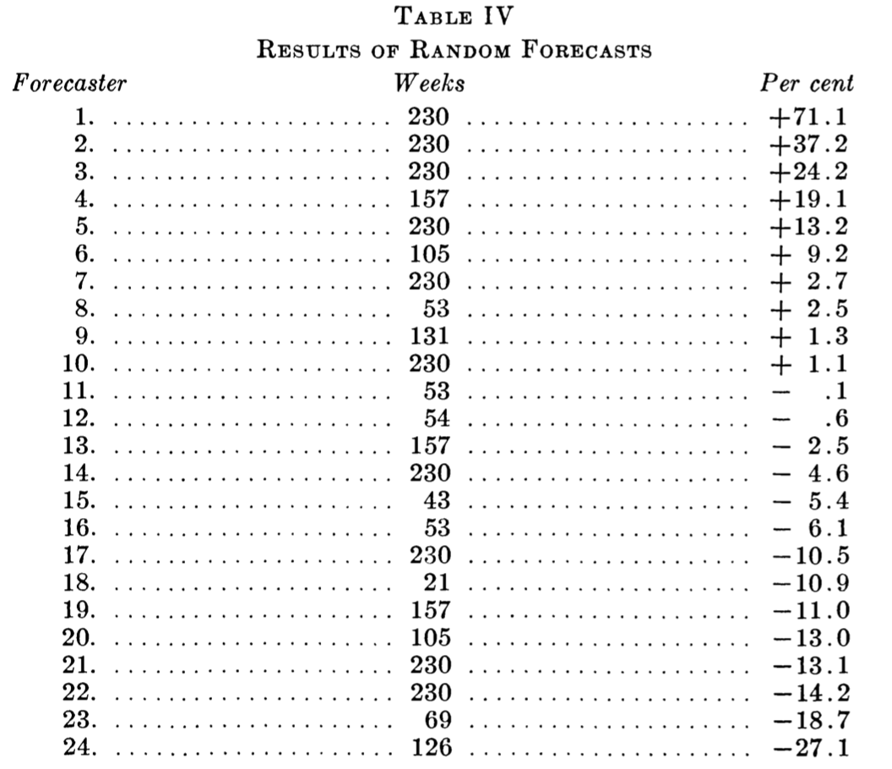
Statistical Interpretations of Results

Slide 15
Statistical Interpretations of Results
Notes:
And this graph is easier for comparison. You can see here that the most successful forecast is quiet close, but the extreme losses of forecasters tend to exceed the losses generated by the pure change operations.

Slide 16
Probability test
Forecasters Number 2, 3, 22 and 24 were chosen as representing the best and the worst whose records covered the entire period under analysis
The weekly forecasts of each of these four were correlated with the first differences of the logarithms of the stock market averages over 4¹/₂ years.
 | Forecaster 2 | Forecaster 3 | Forecaster 22 | Forecaster 24
Correlation coefficient | 0.151 | 0.197 | -0.124 | -0.132
Notes:
For the correlation test therefore, Forecasters Number 2, 3, 22 and 24 were chosen as representing the best and the worst whose records covered the entire period under analysis.
The weekly forecasts of each of these four were correlated with the first differences of the logarithms of the stock market averages over 4' years.
Fore- casterNumber 2 had a correlation coefficient of .151; Forecaster Num- ber 3, of .197; and Forecasters Number 22 and 24, of -.124 and -.132 respectively. The probable error of the best correlation coefficient, with n = 230, was .043.

Slide 17
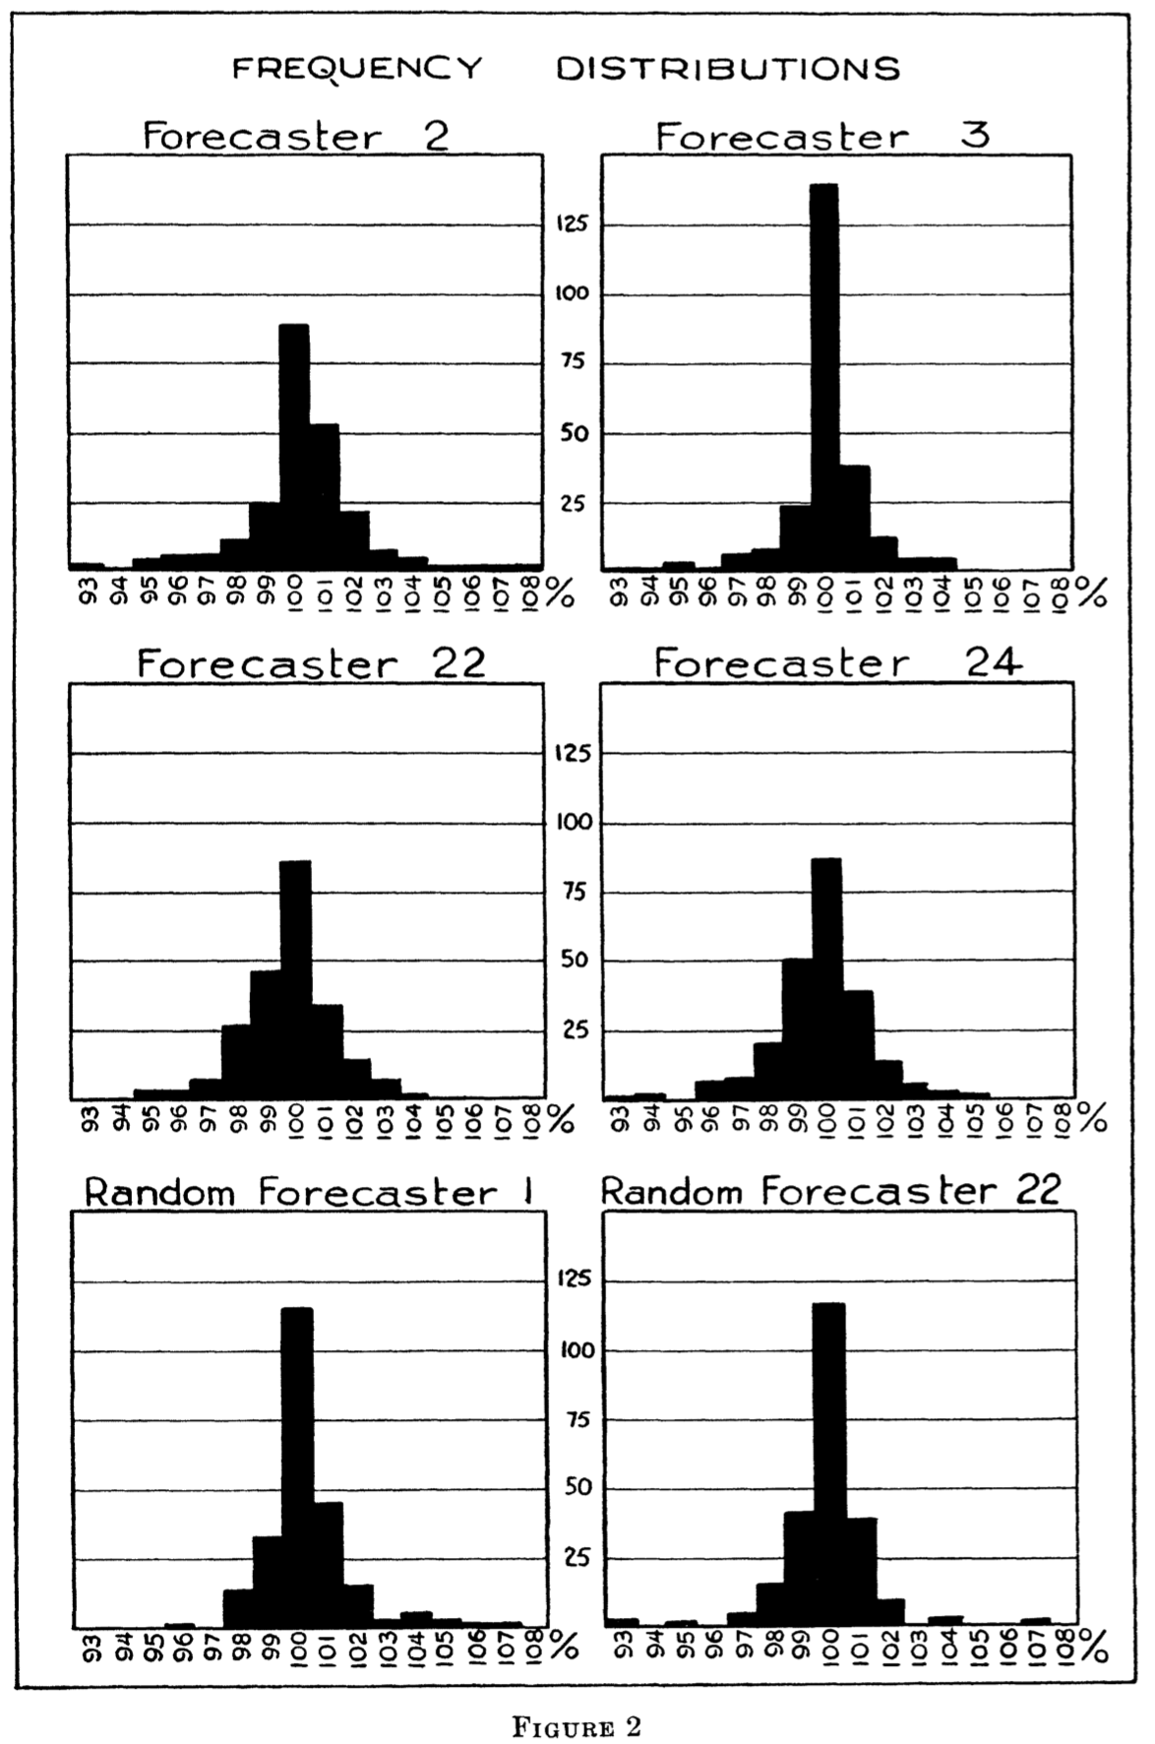
Frequency distribution of weekly % G/L
 | Average
Forecaster 2 | 100.098
Forecaster 3 | 100.103
Forecaster 22 | 99.674
Forecaster 24 | 99.711
Random Forecaster 1 | 100.213
Theoretical | 100
Error | 0.086
Notes:
measuring the spread of the performances of the individual forecasters by means of frequency distributions of the percentage weekly gains and losses of each of six forecasters divided by the average result of all possible forecasts.
The theoretical average is 100, which represents the average of all random distribution.
The probable error of the latter was found to be .086. Forecasters Number 2 and 3 showed averages of 100.098 and 100.103 respectively; each deviating from the theoretical average by amounts which were slightly greater than the probable error .086, but considerably less than twice this probable error. Forecasters Number 22 and 24 had averages of 99.674 and 99.711 respectively; less than the theoretical average by .326 and .289. Each of these differences was more than three, and less than four, times greater than the probable error .086. When a similar frequency distribution is made for the best purely random forecaster, it is found that the average was equal to 100.213, which is greater than that of Forecasters 2 and 3. The deviation from the theoretical average lies within three times the probable error of this theoretical average.

Slide 18
Summary
 | Time frame | Performance
16 finance services | January 1928 – July 1932 | - 1.43%
20 fire insurance companies | 1928-1931 | - 1.2 %
William Peter Hamilton | 1904-1929 | - 3%
24 financial publications | January 1928 – June 1932 | -4%
Notes:
16 financial services, in making 7500 recommendations of individual stocks for investment, achieve a return of 1.43% below market average
20 fire insurance companies, in making similar security selection, achieve a return of 1.2% below market average
William Peter Hamilton, during 26 years, achieve a return higher better than normal investment return but worse than index performance. And out of 90 announcement about changes in market outlook, half were successful
24 financial publications, failed as a group by 4% per annum to achieve a result as good as the average of pure random performance
But based on various statistical tests, the most successful records are little, if any, better than what might be expected to result from pure chance. There is some evidence, on the other hand, to indicate that the least successful records are worse than what could reasonably be attributed to chance.

Slide 19
Ideas
Update the data to see if there is any revision of forecasts
Test the performance of risk management

